Slide 1




NEXT GEN EMPLOYABILITY PROGRAM
Creating a future-ready workforce
Team Members
College Name
Student Name :Saleth Krithika D
Student ID :720921243049
JCT College of Engineering & Technology-Coimbatore

Slide 2

CAPSTONE PROJECT SHOWCASE
Project Title
Notes Sharing Web Application using Django Framework
Abstract | Problem Statement | Project Overview | Proposed Solution | Technology Used | Modelling & Results | Conclusion

Slide 3
Abstract
In today's digital age, the demand for convenient and effective educational resources has never been higher. This research introduces a collaborative notes sharing web application developed to address this need by enabling students to easily share academic materials. By utilizing the Django framework, a powerful Python web framework known for its speed and practical design, this platform provides a strong foundation for users to share notes in various formats. The system architecture, based on Django's Model-View-Template (MVT) structure, ensures scalability, ease of maintenance, and clear separation of components. Noteworthy features include user authentication, seamless file management, a user-friendly search tool for quick access to specific materials, and a system for categorizing notes by subject or course. Initial testing has revealed a positive response from users, indicating the application's potential to significantly improve the learning experience through collaborative study and resource sharing. Future developments will focus on adding advanced capabilities like collaborative editing, integration with cloud storage services, and implementing machine learning algorithms to suggest personalized content based on user preferences and study patterns.
Source :Gpt 4

Slide 4
Problem Statement
This project addresses a crucial issue: the absence of a user-friendly and collaborative platform tailored for students and educators to efficiently share and manage academic notes and resources. Existing online platforms lack specialization in academic collaboration, leading many students to resort to fragmented and insecure methods of sharing study materials. The goal here is to harness the capabilities of the Django framework to create a secure, scalable, and intuitive web application. This platform will not only simplify the sharing and organization of notes but also elevate the learning experience through collaborative tools and a community-centric design.
Source :

Slide 5
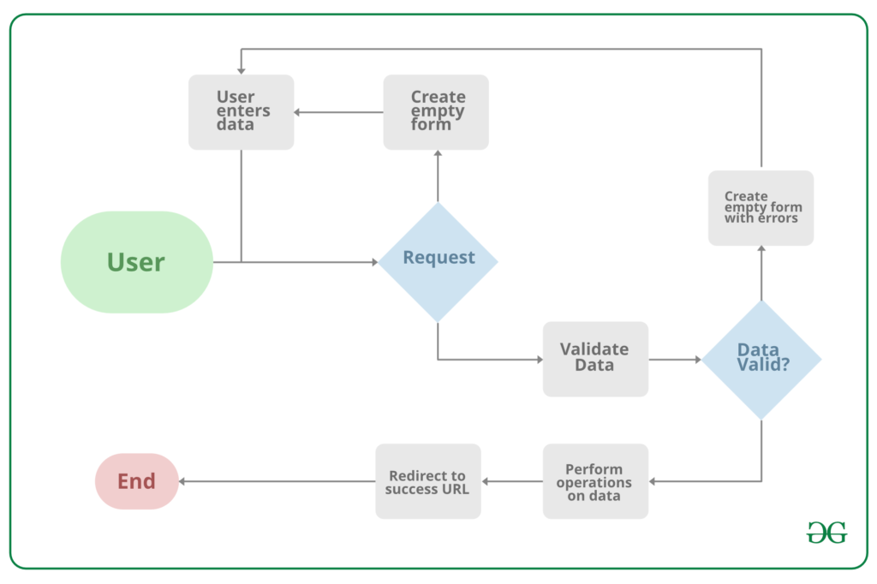
Project Overview
Source :google

Slide 6
Proposed Solution
The proposed solution involves creating a robust and secure Notes Sharing Web Application tailored for students, educators, and academic institutions. This application will harness the power of the Django framework known for its strength in security and scalability. Here's an overview of the key aspects:
1. System Architecture
Backend Development: Django will handle the server-side logic, database management, user authentication, and session control, ensuring a solid foundation.
Frontend Integration: HTML, CSS, and JavaScript will be integrated with Django's template system to craft an intuitive and responsive user interface, enhancing usability.
Database Design: A well-structured relational database schema will efficiently store user data, notes, categories, and interactions, ensuring quick access and secure storage.
2. Core Features
User Authentication and Authorization: Leveraging Django's built-in authentication, users will have secure account management, ensuring privacy.
Notes Management: Users can easily upload, download, and manage notes in various formats (PDF, DOCX, PPT), with options to create, edit, and remove notes.
Collaboration Tools: The platform will offer features for note commenting, rating, and discussions, fostering a collaborative learning ecosystem.
.
Source : GPT 4

Slide 7
3. Security and Privacy
Implement Django’s security best practices to protect against common vulnerabilities such as SQL injection, Cross-Site Scripting (XSS), and Cross-Site Request Forgery (CSRF).
Ensure data privacy by adhering to regulations such as GDPR for the handling of personal information.
4. Scalability and Performance
Design the application with scalability in mind, allowing for easy adaptation to increased user numbers and data volume without performance degradation.
Utilize Django’s caching framework to enhance application performance and reduce server load.
5. User Experience (UX) Design
Follow a user-centered design approach to create an accessible and engaging platform, ensuring that the UI/UX caters to the needs and preferences of the target audience.
Implement responsive design principles to ensure the application is accessible across various devices and screen sizes.
6. Testing and Quality Assurance
Conduct thorough testing, including unit tests, integration tests, and user acceptance testing (UAT), to ensure the application is reliable, secure, and user-friendly.
Utilize Django’s testing framework to automate test cases and ensure code integrity.
Source :GPT 4

Slide 8


Technology Used
Front-end
Back-end
Source :

Slide 9
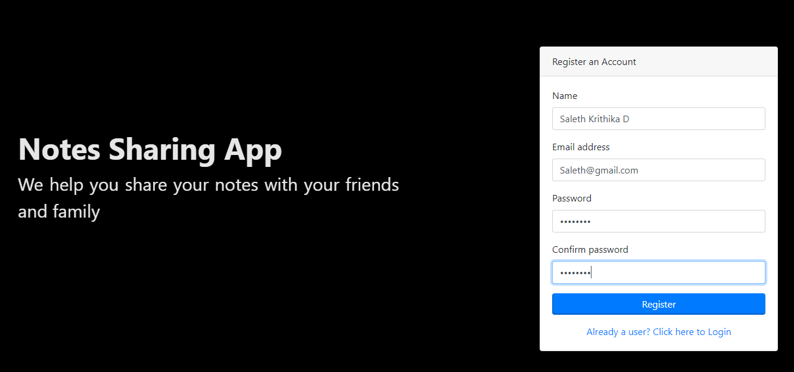
Modelling & Results
Source :

Slide 10
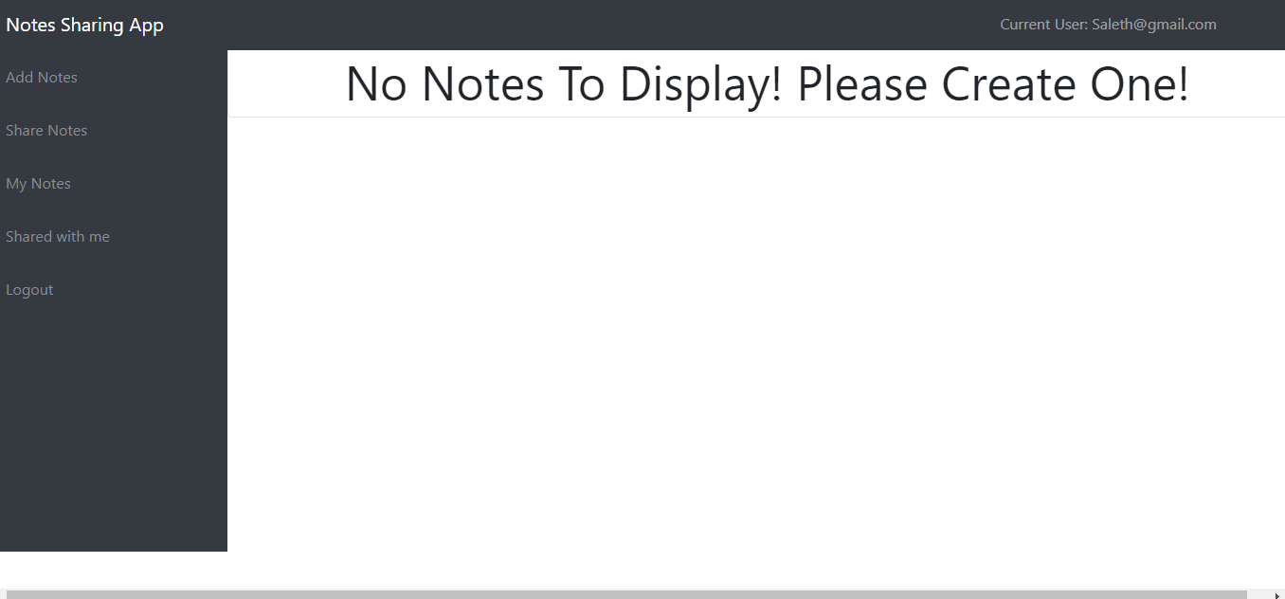
User-Profile

Slide 11
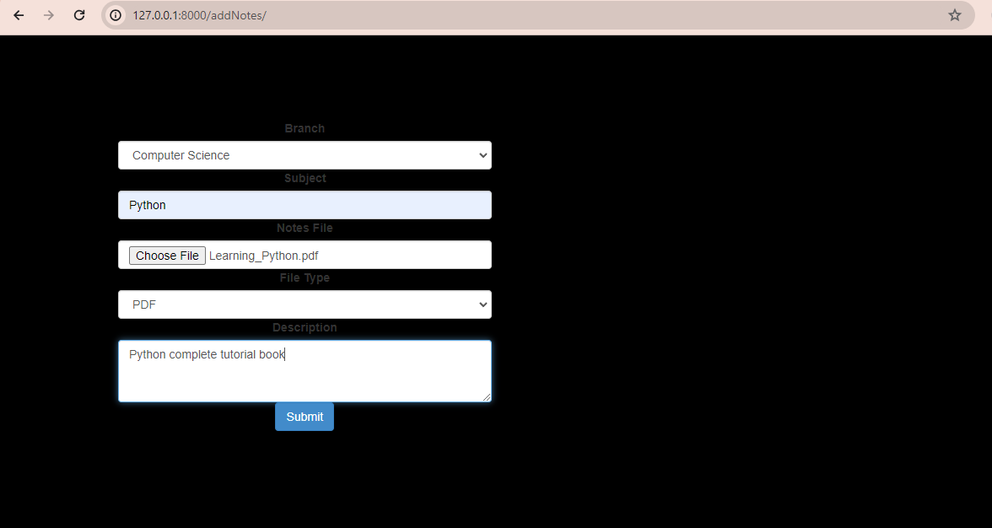
User-Profile

Slide 12
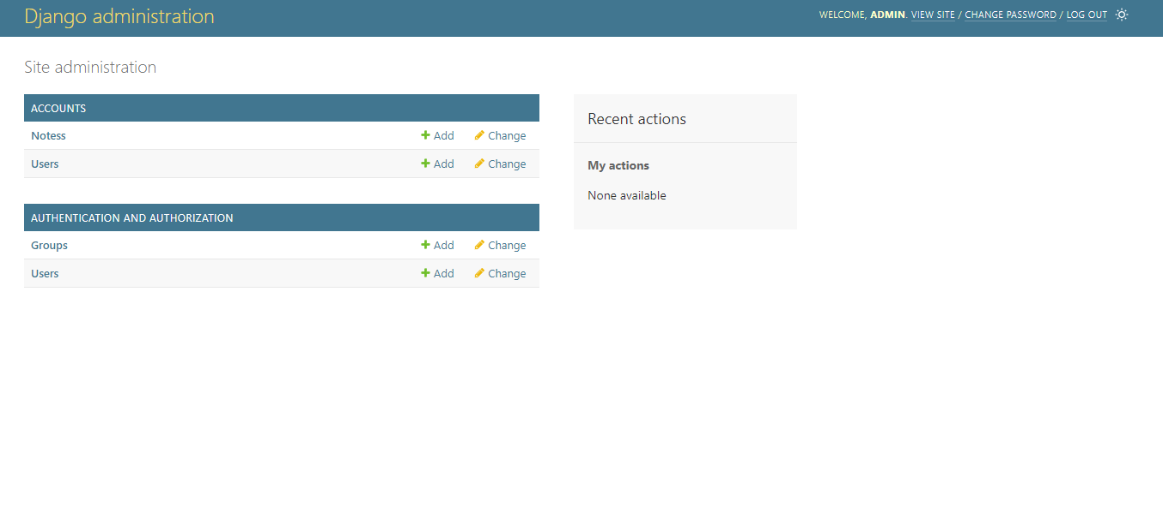
Admin-Page

Slide 13
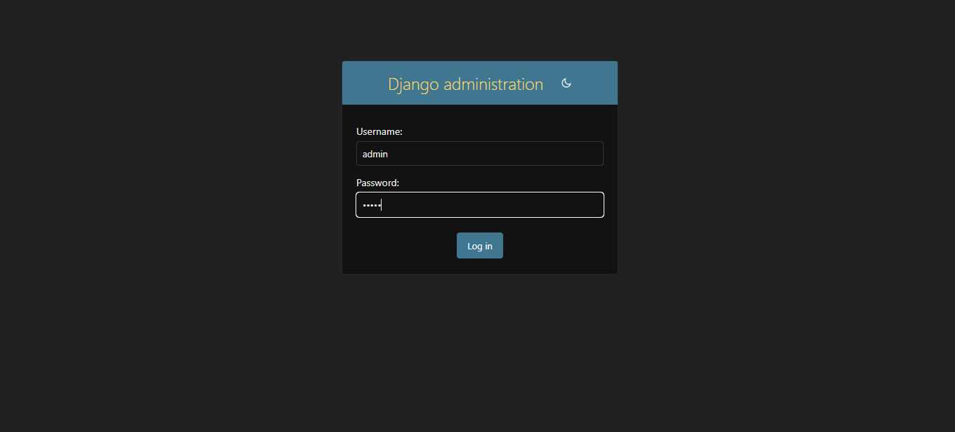
Admin log in

Slide 14
Future Enhancements:
1. Artificial Intelligence and Machine Learning Integration
To enhance user experience, the application will integrate cutting-edge AI and machine learning algorithms. A Content Recommendation System will be developed, leveraging user behavior analysis to offer personalized note suggestions. Additionally, Natural Language Processing (NLP) techniques will be employed for Automatic Categorization, streamlining note organization based on content for efficient uploads and improved resource discovery.
2. Enhanced Collaboration Features
The application will introduce innovative collaboration tools for seamless teamwork. Real-Time Collaboration functionalities, akin to Google Docs, will enable simultaneous editing and commenting on documents. Study Groups will be facilitated within the app, empowering users to create and join study groups for a more organized and collaborative learning environment.
3. Integration with External Platforms
Users will benefit from seamless integration with popular cloud storage services like Google Drive and Dropbox for effortless note uploads and backups. Furthermore, the application will integrate with diverse educational tools and platforms, offering users a consolidated hub to access an array of educational resources and tools within a single interface.

Slide 15
Conclusion
In conclusion, note sharing applications are invaluable tools that facilitate collaboration, knowledge exchange, and organization across various domains. Whether used for educational purposes, professional endeavors, or personal organization, these platforms provide a centralized hub for users to create, share, and collaborate on notes. By promoting efficient communication, enhancing productivity, and fostering learning and growth, note sharing applications empower individuals, teams, and communities to connect, collaborate, and succeed in the digital age. As technology continues to advance, the importance and impact of note sharing applications are expected to increase, offering crucial support for collaboration and knowledge sharing in diverse contexts.
Source :

Slide 16
Thank You!
Notes:
Thank You !!

